Slide 1
Lesson 13 - Java Database Connectivity

Slide 2
Lesson Goals
Connect to Database (DB)
Manipulate with database structure
Operate with database content
2

Slide 3
Database
Data - information
Database - organized collection of data
Database types:
Relational (RDB) - tables of rows and columns;
Non-relational (No-SQL) - non-structured;
New-SQL – mixed.
Notes:
3

Slide 4
Terminology
DDL - Data Definition Language
DML - Data Manipulation Language
SQL – Structured Query Language

Slide 5
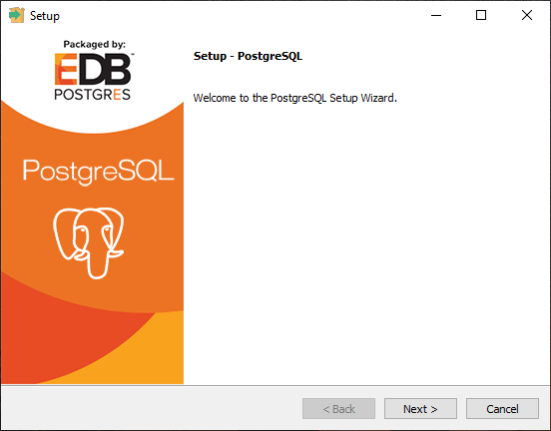

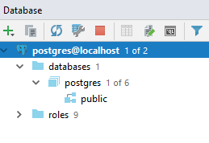
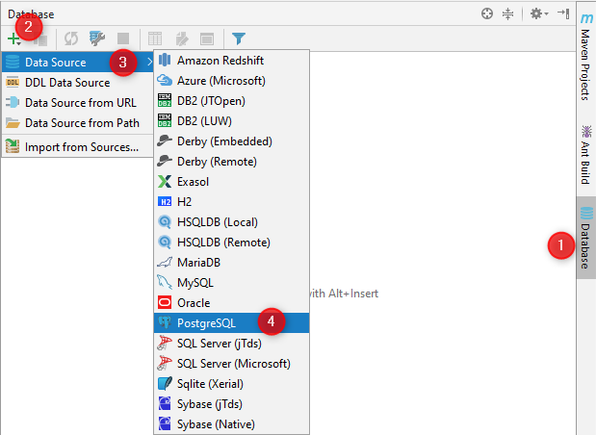
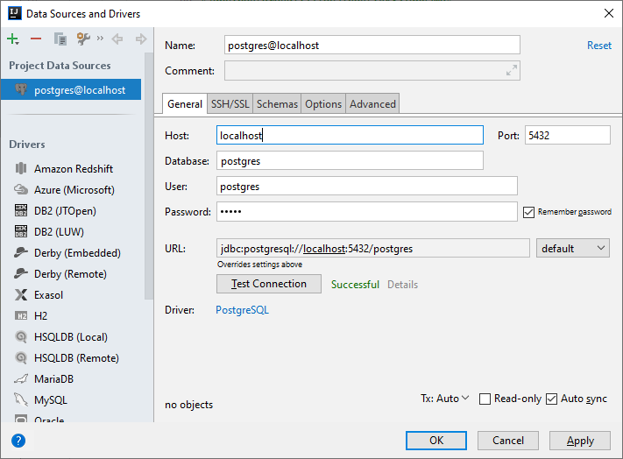
Setup database
5

Slide 6
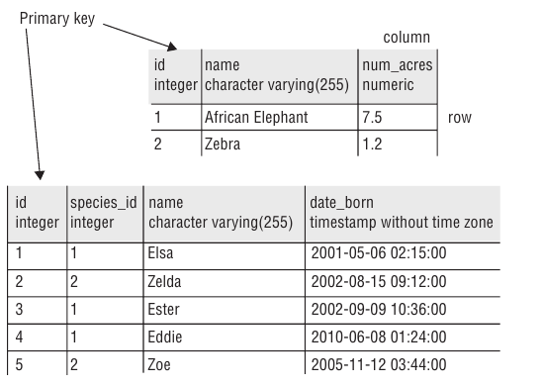
Structure of a relational database

Slide 7
Define a database structure
create database yaroslav_brahinets;
create table species ( id serial primary key, name varchar(256) not null, num_acres float not null );
create table animal ( id serial primary key, species_id integer not null, name varchar(256) not null, date_born timestamp not null, constraint animal_species_id_fkey foreign key (species_id) references species (id) );
7

Slide 8
JDBC: Java Database Connectivity
JDBC - platform-independent industry standard for the interaction of Java-applications with various DBMS
Java Application
Database
JDBC v4.3
Driver

Slide 9
Ways to access RDB from Java
JDBC - accesses data as rows and columns;
JPA (Java Persistence API) - accesses data through Java objects using a concept called object-relational mapping (ORM);

Slide 10
Database flow
Load driver;
Get a connection;
Get a statement;
Execute queries;
Read results/metadata;
Close resources.
10

Slide 11
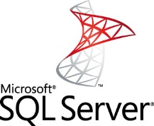
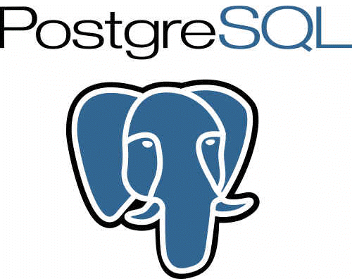



Driver
MySQL
MS SQL
Server
PostgreSQL
Oracle
SQLite
MySQL
JDBC
Driver
MS SQL
JDBC
Driver
PostgreSQL
JDBC
Driver
Oracle
JDBC
Driver
SQLite
JDBC
Driver
JDBC Interface
Java Application

Slide 12
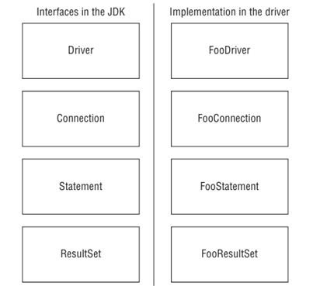
Key JDBC interfaces

Slide 13
Key JDBC interfaces
Driver - how to get a connection to the database
Connection - how to communicate with the database
Statement - how to run the SQL
ResultSet - what was returned by queries and how to work with that

Slide 14
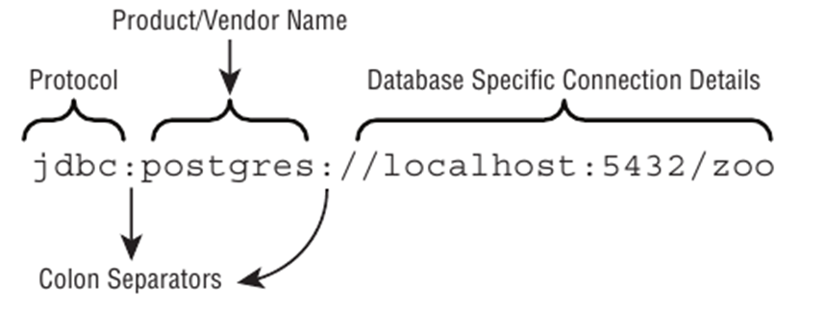
Database connection URL

Slide 15
Get a Connection
Connection connection = DriverManager.getConnection( "jdbc:postgresql://localhost:5432/dbname", "username",
"password" );
// do manipulations with database

Slide 16
Statements
Statement | PreparedStatement | CallableStatement
Generic interface for data access and modification Batch operations execution Provides access to result set Sent to the database server each and every time. | Cached. Can be used several times with different parameters; Faster - preliminary construction of the execution plan; More secure - uses placeholders for input parameters, prevents SQL injections; More readable - no string concatenation in building a query; | Interface for running stored procedures and functions; Provides access to specific parameters returned by stored procedures;

Slide 17
Basic SQL Statements
INSERT - add a new row to the table(s)
SELECT - fetch data from the table(s)
UPDATE - change zero or more rows in the table(s)
DELETE - remove zero or more rows from the table(s)

Slide 18
CRUD – Create, Read, Update, Delete
Statement statement = connection.createStatement();
ResultSet names = statement.executeQuery("select name from animal");
int insertedRowsCount = statement.executeUpdate(
"insert into animal values(1, 2, 'Deer', ‘01-01-2020')“
);
int updatedRowsCount = statement.executeUpdate(
"update animal set name = ‘Big Deer‘ where name = ‘Deer’“
);
int deletedRowsCount = statement.executeUpdate(
"delete from animal where id = 1“
);

Slide 19
Prepared Statement
final String animalToFree = "Zebrony";
Statement stmt = connection.createStatement(); String sql = "delete from animal where name = '" + animalToFree + "'"; stmt.executeUpdate(sql);
PreparedStatement ps = connection.prepareStatement(
"delete from animal where name = ?“
); ps.setString(1, animalToFree); ps.execute();

Slide 20
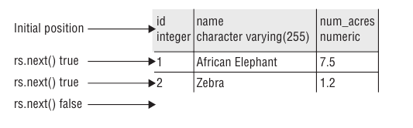
Getting Data from a ResultSet

Slide 21
Getting Data from a ResultSet
ResultSet rs = statement.executeQuery(
"select id, species_id, name, date_born from animal“
); List<Animal> animals = new ArrayList<>(); while (rs.next()) { Animal animal = new Animal( rs.getInt("id"), rs.getInt("species_id"), rs.getString("name"), rs.getTimestamp("date_born") ); animals.add(animal); }
Notes:
21

Slide 22
Getting Data from a ResultSet
Method Name | Return Type | Example Database Type
getBoolean | boolean | BOOLEAN
getDate | java.sql.Date | DATE
getDouble | double | DOUBLE
getInt | int | INTEGER
getLong | long | BIGINT
getObject | Object | Any type
getString | String | CHAR, VARCHAR
getTime | java.sql.Time | TIME
getTimeStamp | java.sql.TimeStamp | TIMESTAMP
Notes:
Keep attention that return type are primitives. When null is stored in database, then default value will be returned for type during result set processing
22

Slide 23
What is wrong?
try (Connection connection = DriverManager.getConnection( "jdbc:postgresql://localhost:5432/db", "username", "password" ); Statement stmt = connection.createStatement(); ) {
ResultSet rs = stmt.executeQuery("select * from animal where name = 'Not in table'"); rs.next(); rs.getInt(1);
// missing check that rs.next() returned false due no entry
ResultSet rs1 = stmt.executeQuery("select count(*) from animal"); rs1.getInt(1);
// missing rs.next() invocation
ResultSet rs2 = stmt.executeQuery("select count(*) from animal"); rs2.next(); rs2.getInt(0);
// invalid column index, indexing starts from 1
} catch (SQLException e) { /* process exception... */ }

Slide 24
Transaction - statements executed as a unit
connection.setAutoCommit(false);
try { final int unicornSpeciesId = 2; statement.executeUpdate("delete from animal where species_id =“ +unicornSpeciesId); statement.executeUpdate("delete from species where id =“ +unicornSpeciesId); connection.commit(); } catch (SQLException e) { // process exception }
connection.setAutoCommit(true);

Slide 25
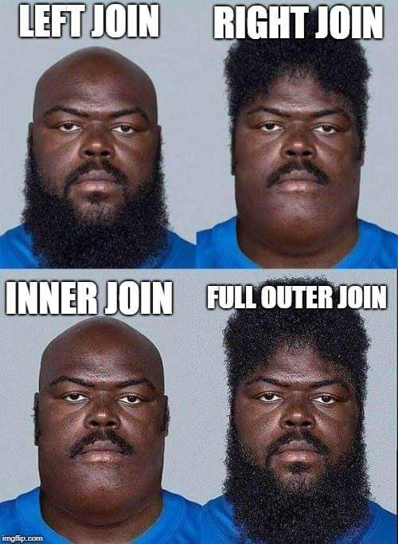
Joining multiple tables
ResultSet rs = statement.executeQuery(
"select animal.name as Name, species.name as Species, animal.date_born as Born from animal inner join species on animal.species_id = species.id
“); while (rs.next()) { String name = rs.getString(“name"); String species = rs.getString("species"); Date bornDate = rs.getTimestamp("born"); }
25

Slide 26
SQLException
try { // code throwing SQL excetion } catch (SQLException e) { logger.error(
"Error during query execution {}. State {}. Error code {}", e.getMessage(), e.getSQLState(), e.getErrorCode() ); }

Slide 27
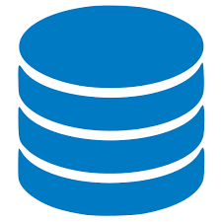
Database metadata
DatabaseMetaData databaseMetaData = connection.getMetaData();
Programmability
Tables
Columns
animal_statistics (@date, @ids)
animal
id
select * from animal
where date_born = @date
and id in (@ids)
group by species_id
species
name
species
date_born
Views
unique_animals
top_species
rare_animals

Slide 28
Closing Database Resources
try (Connection connection = DriverManager.getConnection( "jdbc:postgresql://localhost:5432/dbname", "username", "password" );
Statement statement = connection.createStatement(); ) {
// do manupulations with database
} catch (SQLException e) { // process exception... }

Slide 29
Performance optimization
HikariCP
Apache DBCP
C3P0
Connection Pool
Connection
DB
Connection
Java Application
Connection
getConnection()
Connection

Slide 30
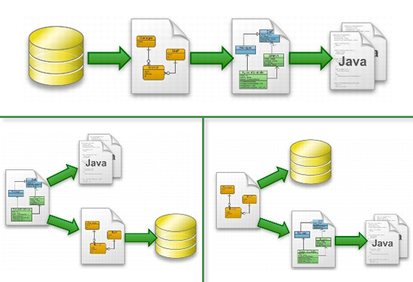
Object-Relational Mapping (ORM)
Hibernate
OpenJPA
EclipseLink
ORMLite
Notes:
High level libraries for work with DB
30

Slide 31
Data consistency
Atomicity - each transaction should be "all or nothing“;
Consistency - any transaction should bring the database from one valid state to another valid state;
Isolation - concurrent execution of transactions results in a system state that would be obtained if transactions were executed serially;
Durability - once a transaction has been committed, it will remain so, even in the event of power loss.

Slide 32
Good practices
Use underscores to separate "words” in column and table names (PostgreSQL);
Use singular form for tables naming;
Access data by column name but not column index;
Close resources. Use connection pool;
32

Slide 33
Homework
Integrate databases to the project (Postgres server):
Name is a student representative for ex. “yaroslav_brahinets”;
Tables should be automatically populated on program startup. If tables already exist - skip this step and log appropriate message to console;
Declare host, port, login, password and database_name in application.properties file located in projects resources;
Add database as a storage to your project. Do all application activities with selected source.
33

Slide 34
Literature
Java JDBC (Baeldung)
PostgreSQL
Java Database Connectivity (Oracle)
Relational vs Non-relational databases
34
Notes:
34

Slide 35
Thanks!
Any Questions?
Or find us in Slack:
@Yaroslav Brahinets
@Vasya Rudas
35

